Slide 1

Distributed & Cloud Computing
Welcome
Sukkur IBA University
Week - 04
Lecture – 07&08
Your Facilitator, Adil Khan

Slide 2
Recap
Service Level Agreement (SLA)
Types of SLA
Key Performance Indicator (KPI)

Slide 3
Virtualization

Slide 4
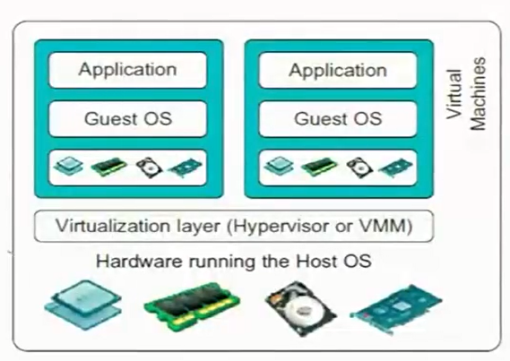
What is Virtualization?
Virtualization was originated in the 1960s at IBM.
Allows concurrent execution of multiple OSs on same physical machine
Virtual Resources = each OS thinks that it “owns” hardware resources
Virtual Machine (VM) = OS + applications + virtual resources
Virtualization layer = management of physical hardware (virtual machine monitor, hypervisor)

Slide 5
Benefits of Virtualization
Consolidation
Ability to run multiple VMs, with their OS and applications on a single physical platform
Decrease cost and improve manageability
Migration:
Migrate OS from one physical machine to another physical machine
Security:
OS and applications encapsulated in VM and provide isolation
Any malicious behavior only affect resources of single VM on entire hardware

Slide 6
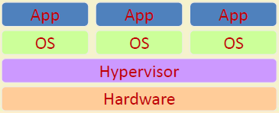
Cloud and Virtualization
Virtual Workspaces:
An abstraction of an execution environment that can be made dynamically available to authorized clients by using well-defined protocols,
Resource quota (e.g. CPU, memory share),
Software configuration (e.g. OS).
Implement on Virtual Machines (VMs):
Abstraction of a physical host machine,
Hypervisor intercepts and emulates instructions from VMs, and allows management of VMs,
VMWare, Xen, KVM etc.
Provide infrastructure API:
Plug-ins to hardware/support structures

Slide 7
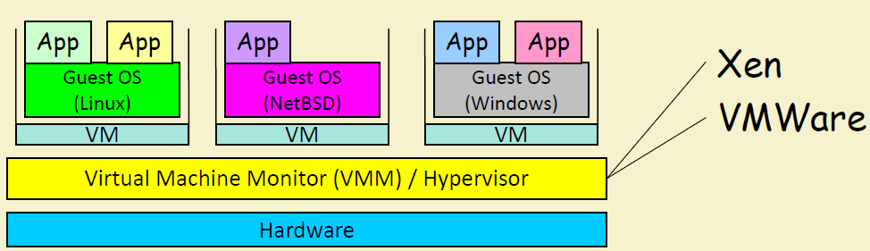
Virtual Machines
VM technology allows multiple virtual machines to run on a single physical machine

Slide 8
Virtualization in General
Advantages of virtual machines:
Run operating systems where the physical hardware is unavailable,
Easier to create new machines, backup machines, etc.,
Software testing using “clean” installs of operating systems and software,
Emulate more machines than are physically available,
Timeshare lightly loaded systems on one host,
Debug problems (suspend and resume the problem machine),
Easy migration of virtual machines (shutdown needed or not).

Slide 9
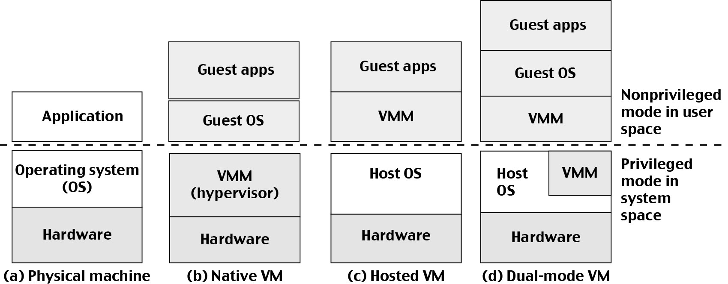
Three VM Architectures

Slide 10
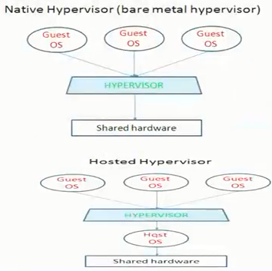
Virtualization Models
Mainly two popular models of virtualization:
Bare-metal hypervisor or native hypervisor (Type I)
Hosted hypervisor (Type II)

Slide 11
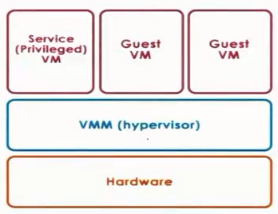
Bare-metal virtualization model
Bare-metal hypervisor (Type I)
VMM (Hypervisor): manage all hardware resources and support execution of entire VMs
Privileged, service VM: to deal with devices (and other configuration and management task)

Slide 12
Bare-metal virtualization model
This model is adapted by the Xen virtualization solution (open source or Citrix Xen Server) and also by the VMware’s hypervisor, the ESX hypervisor.
(i) Xen (Open source or Citrix Xen Server)
The VMs that are run in the virtualized environment are referred to as domains
The privileged domain is called dom 0, and the guest VMs are referred to as domUs
Xen is the actual hypervisor and all of the drivers are running in the privileged domain, in dom 0.
(ii) ESX (Vmware)
Given that VMware and its hypervisors were first to market, VMware still owns the largest percentage of virtualized server cores.
These server cores run the ESX hypervisor and provide the drivers for different devices
VMware support third party community of developers and export number of APIs

Slide 13
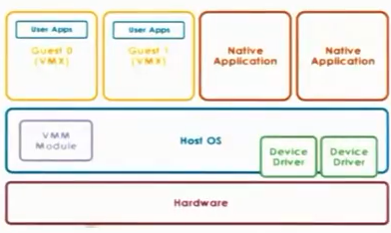
Hosted virtualization model
Hosted Hypervisor (Type II)
In this model, at the lowest level there is a full fledged host OS that manages all of the hardware resources
The host OS integrates a VMM module
VMM responsible for providing the virtual machines with their virtual platform interface and for managing all of the context switching scheduling etc.

Slide 14
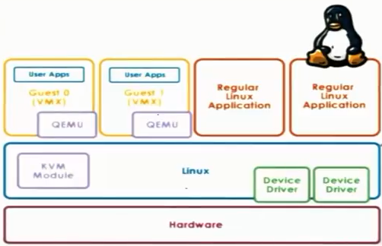
Hosted virtualization model
Example:
KVM (kernel-based VM)
Based on Linux
KVM kernel module + hardware emulator called QEMU for hardware virtualization
Leverages large Linux open-source community

Slide 15
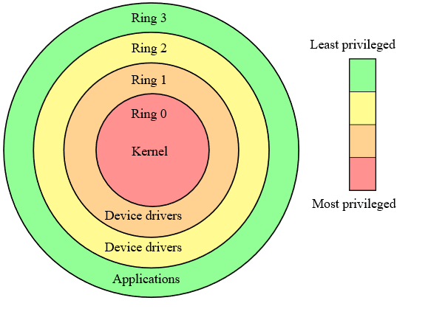
Hardware Protection levels
Hardware actually has more than two protection levels.
E.g. x86 architecture has four protection levels called rings.
Ring 0: has the highest privilege and can access all of the resources and execute all hardware-supported instructions
Ring 3: In contrast, ring 3 has the least level of privilege, so this is where the application would reside

Slide 16
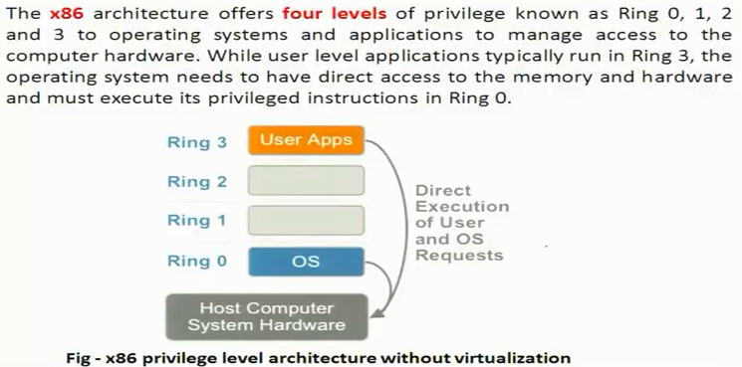
x86 Hardware without virtualization

Slide 17
Processor Virtualization

Slide 18
Processor Virtualization (Trap-and-Emulate)
Guest instructions
Executed directly by hardware
For non-privileged operations: hardware speeds=>efficiency
For privileged operations: trap to hypervisor
Hypervisor determines what needs to be done:
If illegal operation: terminate VM
If legal operation: emulate the behavior the guest OS was expecting from the hardware

Slide 19
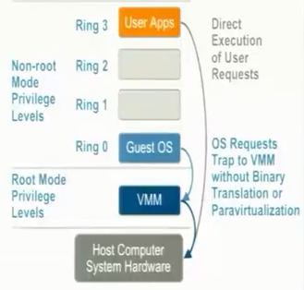
Problems with Trap-and-Emulate
X85 pre 2005
4 rings, no root/non-root modes yet
Hypervisor in ring 0, guest OS in ring 1
But, 17 privileged instructions do not trap! Fail silently!
E.g. interrupt enable/disable bit in privileged register, POPF/PUSHF instructions that access it from ring 1 fail silently
Hypervisor doesn’t know, so it doesn’t try to change settings
OS doesn’t know, so assume change was successful

Slide 20
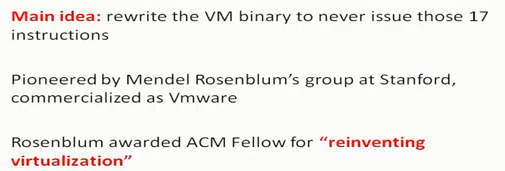
Binary Translation

Slide 21
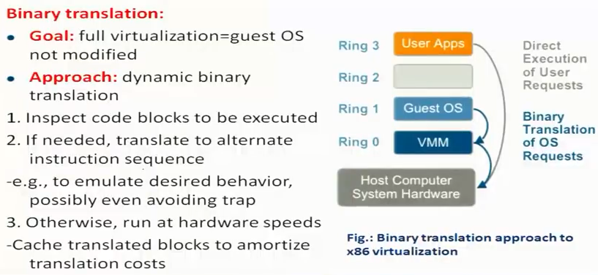
Full Virtualization: Binary Translation

Slide 22
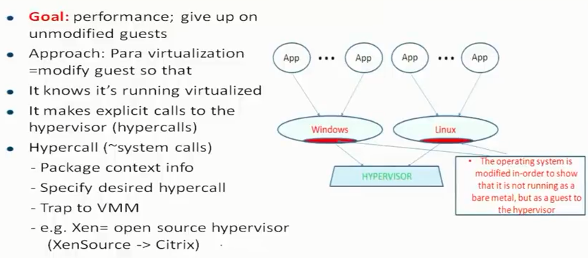
Para Virtualization

Slide 23
Memory Virtualization

Slide 24
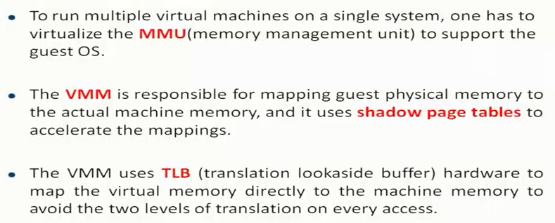
Memory Virtualization

Slide 25
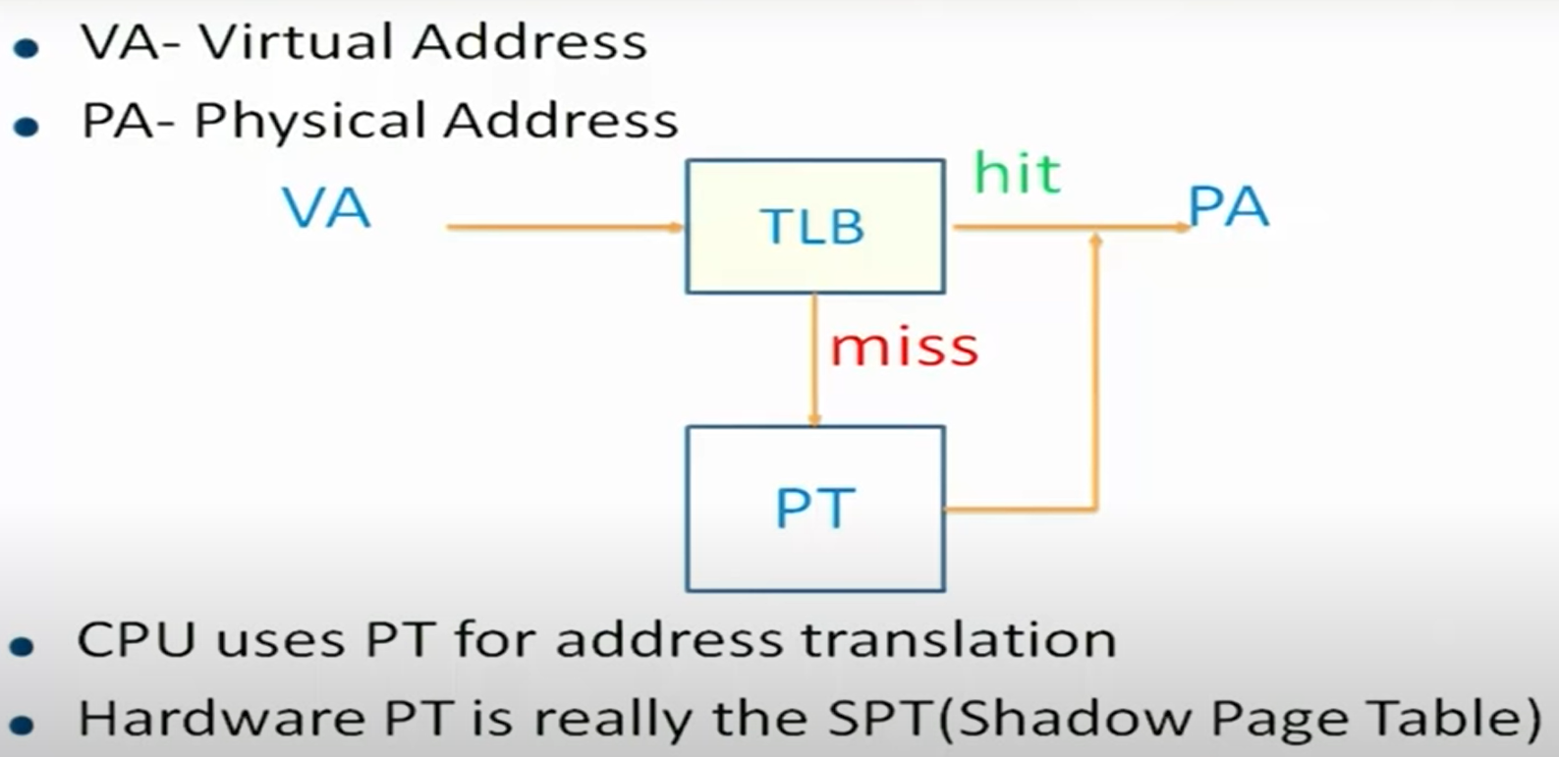
Shadow Page Table

Slide 26
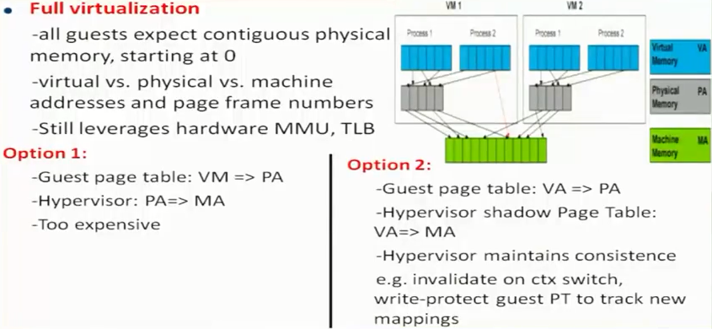
Memory Virtualization

Slide 27
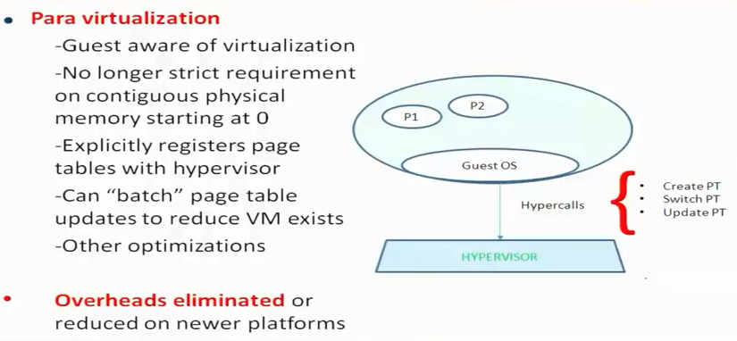
Memory Virtualization

Slide 28
Device Virtualization

Slide 29
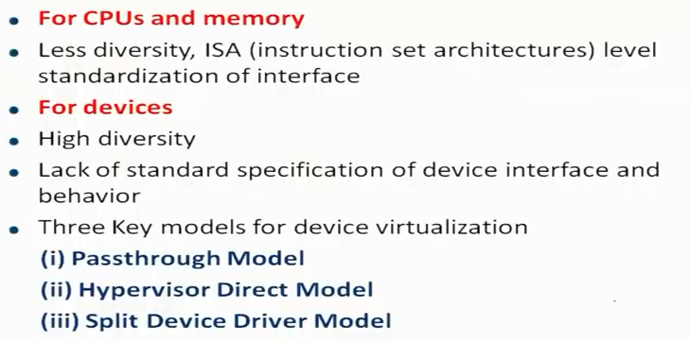
Device Virtualization

Slide 30
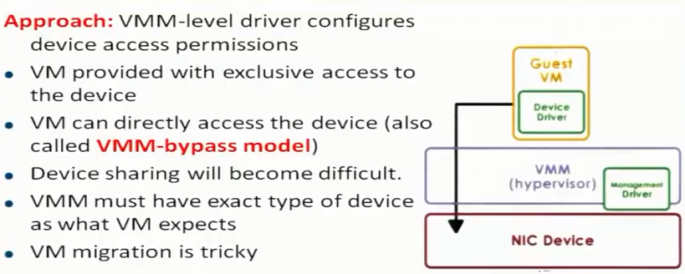
Pass-through Model

Slide 31
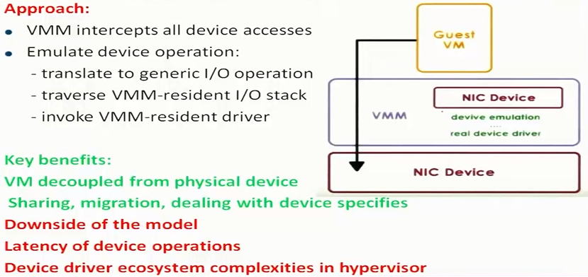
Hypervisor-Direct Model

Slide 32
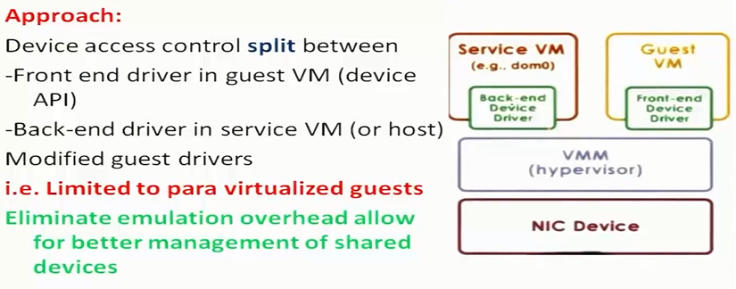
Split-Device Driver Model

Slide 33
Network Virtualization

Slide 34
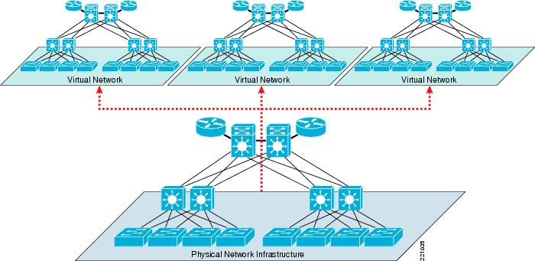
Network Virtualization
What is network virtualization ?

Slide 35
Network Virtualization
What is network virtualization ?
In computing, Network Virtualization is the process of combining hardware and software network resources and network functionality into a single, software-based administrative entity, a virtual network.
Hypervisor hosts share logical switches and routers to encapsulate VM-VM data so the physical network is unaffected.
Two categories :
External network virtualization
Combining many networks, or parts of networks, into a virtual unit.
Internal network virtualization
Providing network-like functionality to the software containers on a single system.

Slide 36
Network Virtualization
Desirable properties of network virtualization :
Scalability
Easy to extend resources as need
Administrator can dynamically create or delete virtual network connection
Resilience
Recover from the failures
Virtual network will automatically redirect packets by redundant links
Security
Increased path isolation and user segmentation
Virtual network should work with firewall software
Availability
Access network resource anytime

Slide 37
Network Virtualization
External network virtualization in different layers :
Layer 1
Seldom virtualization implement in this physical data transmission layer.
Layer 2
Use some tags in MAC address packet to provide virtualization.
Example, VLAN.
Layer 3
Use some tunnel techniques to form a virtual network.
Example, VPN.
Layer 4 or higher
Build up some overlay network for some application.
Example, P2P.
Notes:
4. Transport layer: Provides the means for transmitting data between the two connected parties, as well as controlling the quality of service. The main protocols used here are TCP and UDP.
3. Network layer: Handles the routing and sending of data between different networks. The most important protocols at this layer are IP and ICMP.
2. Data link layer: Handles communications between devices on the same network. If layer 3 is like the address on a piece of mail, then layer 2 is like indicating the office number or apartment number at that address. Ethernet is the protocol most used here.
1. Physical layer: Packets are converted into electrical, radio, or optical pulses and transmitted as bits (the smallest possible units of information) over wires, radio waves, or cables.

Slide 38
Network Virtualization
Internal network virtualization in different layers :
Layer 1
Hypervisor usually do not need to emulate the physical layer.
Layer 2
Implement virtual L2 network devices, such as switch, in hypervisor.
Example, Linux TAP driver + Linux bridge.
Layer 3
Implement virtual L3 network devices, such as router, in hypervisor.
Example, Linux TUN driver + Linux bridge + iptables.
Layer 4 or higher
Layer 4 or higher layers virtualization is usually implemented in guest OS.
Applications should make their own choice.

Slide 39
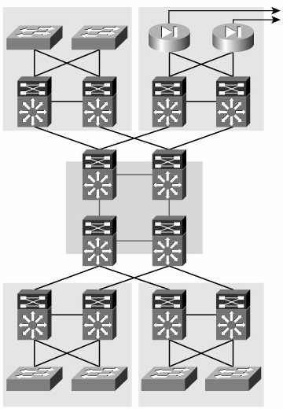
Network Virtualization
Two virtualization components :
Device virtualization
Virtualize physical devices in the network
Data path virtualization
Virtualize communication path between network access points
Data Path
Router
Switch

Slide 40
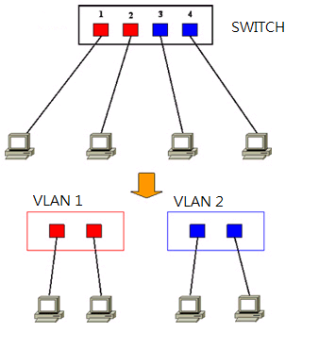
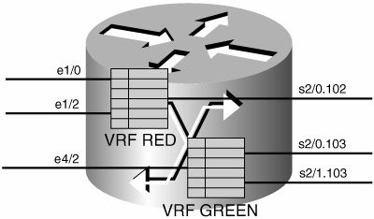
Network Virtualization
Layer 3 solution 3
VRF technique ( Virtual Routing and Forwarding )
Emulate isolated routing tables within one physical router.
Device virtualization
Layer 2 solution
Divide physical switch into multiple logical switches.

Slide 41
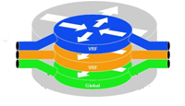
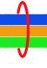
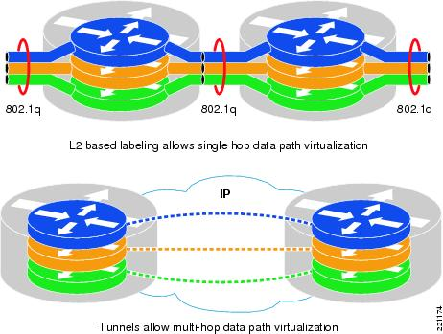
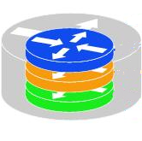
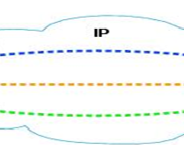
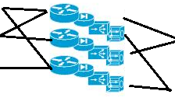
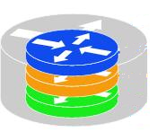
Network Virtualization
Data path virtualization
Hop-to-hop case
Consider the virtualization applied on a single hop data-path.
Hop-to-cloud case
Consider the virtualization tunnels allow multi-hop data-path.

Slide 42
Network Virtualization
Protocol approach
Protocols usually used to approach data-path virtualization.
Three implementations
802.1Q – implement hop to hop data-path virtualization
MPLS ( Multiprotocol Label Switch ) – implement router and switch layer virtualization
GRE (Generic Routing Encapsulation ) – implement virtualization among wide variety of networks with tunneling technique.

Slide 43
Internal Network Virtualization
Internal network virtualization
A single system is configured with containers, such as the Xen domain, combined with hypervisor control programs such as the VNIC, to create a “network in a box”.
This solution improves overall efficiency of a single system by isolating applications to separate containers.
Virtual machine and virtual switch :
The VMs are connected logically to each other so that they can send data to and receive data from each other.
Each virtual network is serviced by a single virtual switch.
A virtual network can be connected to a physical network by associating one or more network adapters (uplink adapters) with the virtual switch.

Slide 44
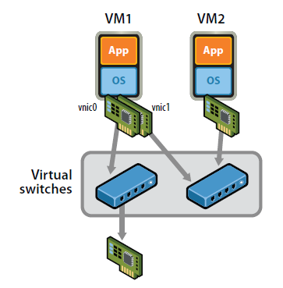
Internal Network Virtualization
Properties of virtual switch
A virtual switch works much like a physical Ethernet switch.
It detects which VMs are logically connected to each of its virtual ports and uses that information to forward traffic to the correct virtual machines.
Typical virtual network configuration
Communication network
Connect VMs on different hosts
Storage network
Connect VMs to remote storage system
Management network
Individual links for system administration

Slide 45
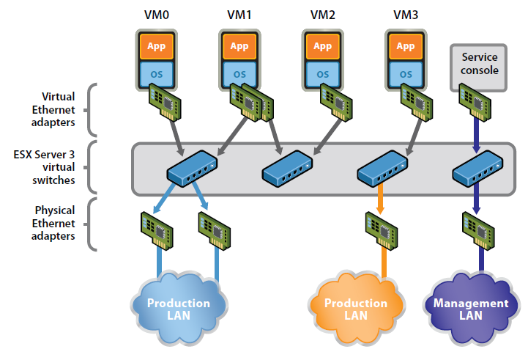
Internal Network Virtualization
Network virtualization example form VMware

Slide 46
Traditional Approach
In KVM system
KVM focus on CPU and memory virtualization, so IO virtualization framework is completed by QEMU project.
In QEMU, network interface of virtual machines connect to host by TUN/TAP driver and Linux bridge.
Work with TUN/TAP and Linux Bridge :
Virtual machines connect to host by a virtual network adapter, which is implemented by TUN/TAP driver.
Virtual adapters will connect to Linux bridges, which play the role of virtual switch.

Slide 47
Traditional Approach
TUN/TAP driver
TUN and TAP are virtual network kernel drivers :
TAP (as in network tap) simulates an Ethernet device and it operates with layer 2 packets such as Ethernet frames.
TUN (as in network TUNnel) simulates a network layer device and it operates with layer 3 packets such as IP.
Data flow of TUN/TAP driver
Packets sent by an operating system via a TUN/TAP device are delivered to a user-space program that attaches itself to the device.
A user-space program may pass packets into a TUN/TAP device. TUN/TAP device delivers (or "injects") these packets to the operating system network stack thus emulating their reception from an external source.

Slide 48
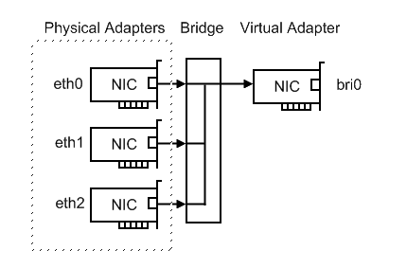
Traditional Approach
Linux bridge
Bridging is a forwarding technique used in packet-switched computer networks.
Unlike routing, bridging makes no assumptions about where in a network a particular address is located.
Bridging depends on flooding and examination of source addresses in received packet headers to locate unknown devices.
Bridging connects multiple network segments at the data link layer (Layer 2) of the OSI model.

Slide 49
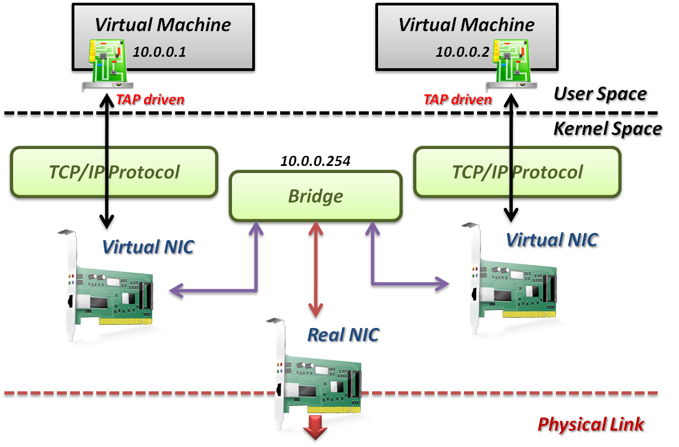
Traditional Approach
TAP/TUN driver + Linux Bridge

Slide 50
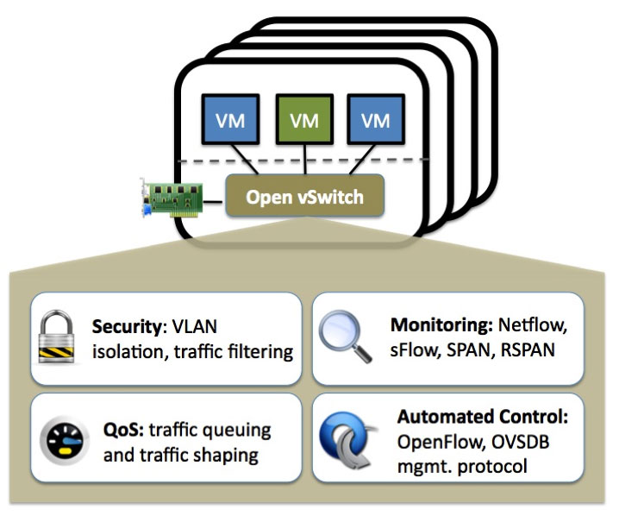
Open vSwicth (OVS)
Open vSwitch (OVS) is an open source multilayer virtual switch.
Usually operates as a software-based network switch
Designed to enable effective network automation via programmatic extensions
Similar to the proprietary virtual switch solutions such as the VMware vSphere Distributed Switch (vDS)
OVS is used with hypervisors to interconnect virtual machines

Slide 51
Advantages And Disadvantages of OVS
Easier for network management – With the Open vSwitch, it is convenient for the administrator to manage and monitor the network status and data flow in the cloud environment.
Support more tunnel protocols – OVS supports GRE, VXLAN, IPsec, etc. However, Linux Bridge only supports GRE tunnel.
Incorporated in SDN – Open vSwitch is incorporated in software-defined networking (SDN) that it can be driven by using an OpenStack plug-in or directly from an SDN Controller, such as OpenDaylight.

Slide 52
Advantages And Disadvantages of OVS
Lacks stability – Open vSwitch has some stability problems such as Kernel panics, ovs-switched segfaults, and data corruption.
Complex operation – Open vSwitch itself is a complex solution, which owns so many functions. It is hard to learn, install and operate.

Slide 53
Thank you!
Any Questions???

